Slide 1
Smart Irrigation System
Smart Drops, Happy Crops!

Slide 2


Introduction
Our project utilizes cutting-edge sensor technology and microcontroller programming to optimize irrigation in agriculture. By monitoring soil moisture, temperature, and humidity in real-time, our system ensures efficient water usage and promotes sustainable farming practices. With automated watering algorithms and user-friendly controls, it offers farmers a simple yet effective solution to enhance crop yield while conserving resources.

Slide 3



Objective
Develop a smart irrigation system with STM32F401CCU6 microcontroller technology, integrating advanced sensors for real-time monitoring of soil conditions. Implement automated watering algorithms for optimal plant growth. Design an intuitive user interface with LED indicators for easy monitoring by farmers.

Slide 4
1. Initialization:
Algorithm
Start the system.
Initialize system components including the microcontroller, sensors, relay
module, and LED indicators.
Data Acquisition:
Enter the main loop.
Read data from soil moisture, temperature, and humidity sensors.
Data Analysis:
Analyze sensor data:
Check if soil moisture is below a predefined threshold. Check if soil temperature is above a predefined threshold.
Decision Making:
If soil moisture is below the threshold or soil temperature is above the threshold:
Activate the water pump via the relay module.
Turn on the red LED indicator to signal watering is needed.
If both conditions are not met: Deactivate the water pump.
Turn on the green LED indicator to signal no watering is needed.

Slide 5
Algorithm
Feedback and Wait:
Provide feedback through LED indicators.
Wait for a predefined interval before repeating the loop.
Loop Continuation:
Repeat the loop to continue monitoring soil conditions and making irrigation decisions.
End:
End the algorithm.

Slide 6
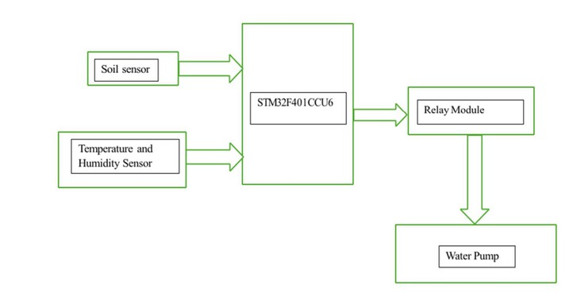
Block Diagram

Slide 7

START
Initialise Microcontroller
Flow Chart
Take Soil moisture, Temperature, Humidity Readings
Check Threshold values for all readings
Wait for 10 secs between each sensor reading
No
If any value falls behind threshold
Yes
On the relay module which will On Water Pump for some time
Off the water pump after that prescribed time
Loop again

Slide 8

Novelty
->Innovative System Design
->Advanced Sensor Integration
->Real-time Environmental Monitoring
->Autonomous Irrigation Algorithms
->Enhanced Plant Care Features
->Technological Advancements

Slide 9



Advantages
Water Conservation Cost Savings Enhanced Plant Health Increased Crop Yield Labor Reduction
User-Friendly Interface Scalability
Environmental Sustainability

Slide 10
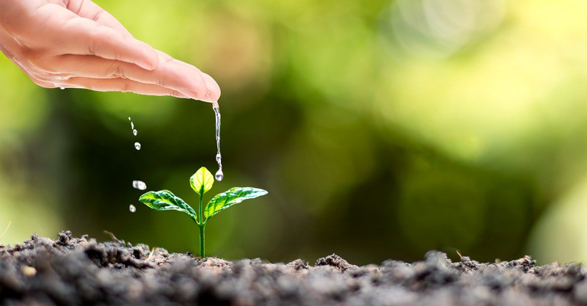






Applications
Agricultural Farming Greenhouse Cultivation Urban Gardening Landscaping Projects Commercial Horticulture
Research and Experimental Farming
A

Slide 11
Result
Implementing the smart irrigation system led to several positive outcomes. It effectively optimized water usage, ensuring that plants received the right amount of water at the right time. This resulted in healthier plant growth, with reduced instances of over or under-watering. Additionally, the automation of irrigation processes reduced the need for manual labor, saving time and resources for farmers. As a result, the system contributed to cost savings and increased crop yields. Moreover, by promoting sustainable farming practices and conserving water resources, it also had a positive impact on the environment.

Slide 12
Conclusion
The Smart Irrigation System represents a significant advancement in agricultural technology, offering a cost-effective and sustainable solution for optimizing water usage and promoting plant health. By leveraging sensor technology and automation, the system addresses the challenges of traditional irrigation methods and contributes to more efficient and environmentally friendly farming practices. With its potential to conserve water, reduce labor, and improve crop yield, the Smart Irrigation System holds promise for revolutionizing agriculture and supporting food security in a changing climate.

Slide 13
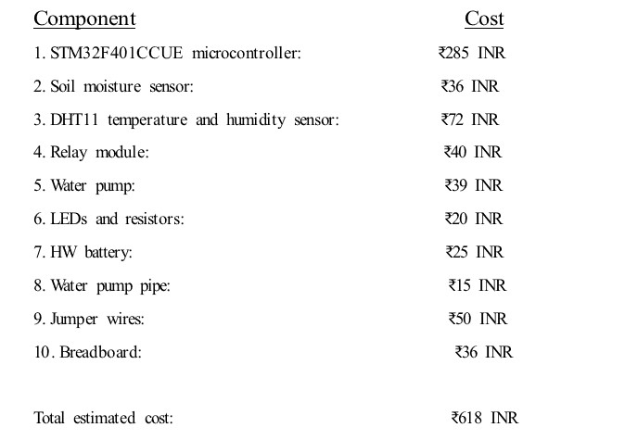

Budget

Slide 14



Our Best Team
SMART IRRIGATION SYSTEM
Durga G
RA2111004010166
Abhinav G
RA2111004010176
Anvesha Dey
RA2111004010145

Slide 15
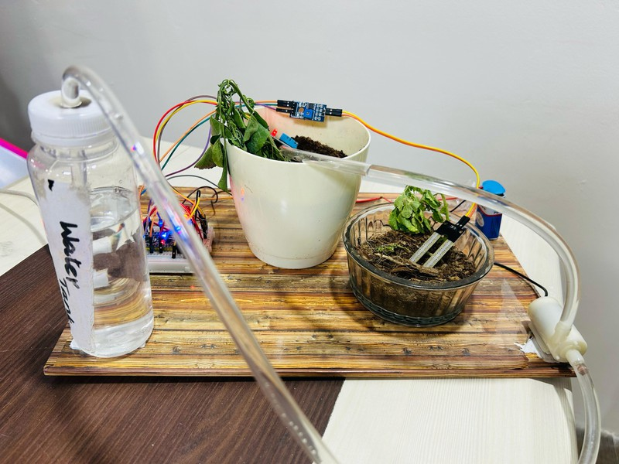
Output

Slide 16

Thank You!

